Slide 1

Vel Tech Rangarajan Dr. Sagunthala R&D Institute of Science and Technology
School of Computing
Department of Computer Science and Engineering
10211CS224 / FULL STACK APPLICATION DEVELOPMENT (JAVA)
PROJECT REVIEW : MILESTONE PROJECT – 1
Date: 03-03-2026
Track Wise: Relational Expense Analytics Platform
SDG: 8 – Decent Work and Economic Growth
Presented By:
S.NAVEEN BABU - VTU26282 – 23UECS0994
Courses Handling Faculty:
Dr. S. Hemamalini

Slide 2
INTRODUCTION
1
In today’s fast-paced world, managing personal and organizational expenses efficiently is a major challenge. Unorganized spending and lack of insights often lead to financial mismanagement and missed opportunities. This project is important as it provides a structured way to track, categorize, and analyze expenses. It helps users understand spending patterns and make informed financial decisions. The platform has real-world relevance in both personal finance management and small business budgeting. It leverages relational analytics to connect transactions across categories, time periods, and sources. Users can visualize data through charts and reports, gaining actionable insights. Overall, the system aims to improve financial literacy, planning, and economic efficiency.
2
3
4
5
6
7
8
9

Slide 3
PROBLEM STATEMENT
1
2
In both personal and organizational contexts, managing expenses is often time-consuming and error-prone, leading to poor financial decisions. Traditional methods like manual tracking or scattered spreadsheets make it difficult to analyze spending patterns, identify unnecessary expenses, and plan budgets effectively. There is a need for a system that relates expenses across categories, timelines, and sources, providing real-time insights and visual analytics to help users make informed financial decisions and improve overall economic efficiency.
3
4
5
6
7
8
9

Slide 4
OBJECTIVE(S)
1
To design and develop a relational expense analytics platform for tracking and categorizing transactions.
Providing users with intuitive dashboards to easily interpret spending patterns and trends.
To implement automated expense tracking across multiple categories and time periods.
Ensuring that users receive real-time reports and insights for informed financial decisions.
To improve financial decision-making through clear visualization of income and expenses.
Reducing unnecessary expenditures and enhancing budget efficiency.
To evaluate the performance of the platform in accurately categorizing and analyzing expenses.
Measuring how effectively dashboards deliver actionable insights to end users.
2
.
3
4
5
6
7
8
9

Slide 5
PROPOSED SYSTEM
1
The system is a relational expense analytics platform that tracks, categorizes, and stores financial transactions.
It provides interactive dashboards and visual reports for easy interpretation of spending patterns.
Automated tracking reduces the manual effort and errors associated with traditional expense recording.
Real-time analytics help users identify unnecessary expenses and optimize budgets.
The platform connects related transactions across categories, time periods, and sources, giving deeper insights.
Alerts and recommendations support better financial decision-making.
Compared to traditional spreadsheets, the system offers improved accuracy, speed, and visualization capabilities.
It enhances financial literacy and planning by giving users actionable insights and trends.
2
3
4
5
6
7
8
9

Slide 6
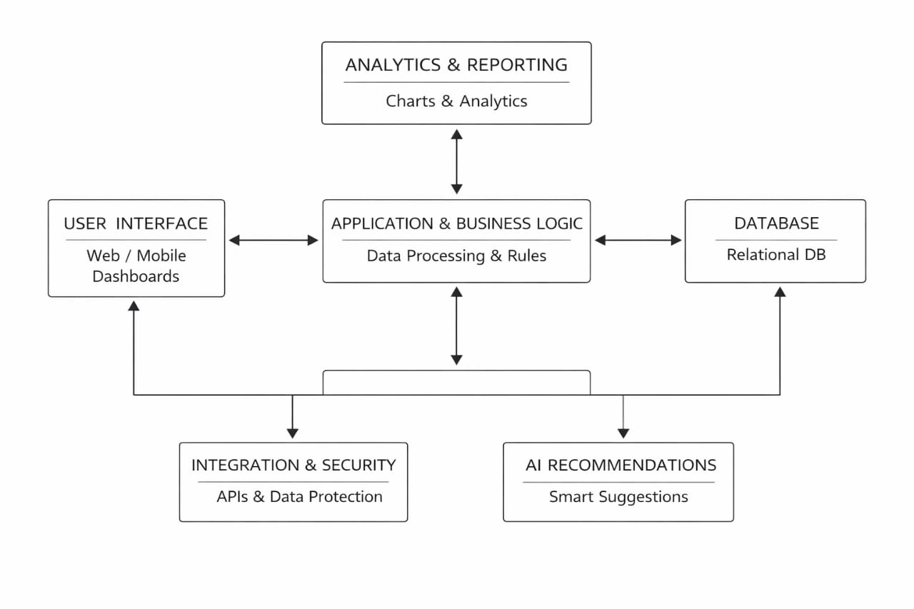
PROPOSED SYSTEM ARCHITECTURE
1
2
3
4
5
6
7
8
9
Input: User enters expense details and budget information through the dashboard.
Processing: The system validates data and applies business rules and calculations.
Database: All data is stored and managed in a relational database.
Output: The system generates the total expense by calculating all the given amount .

Slide 7
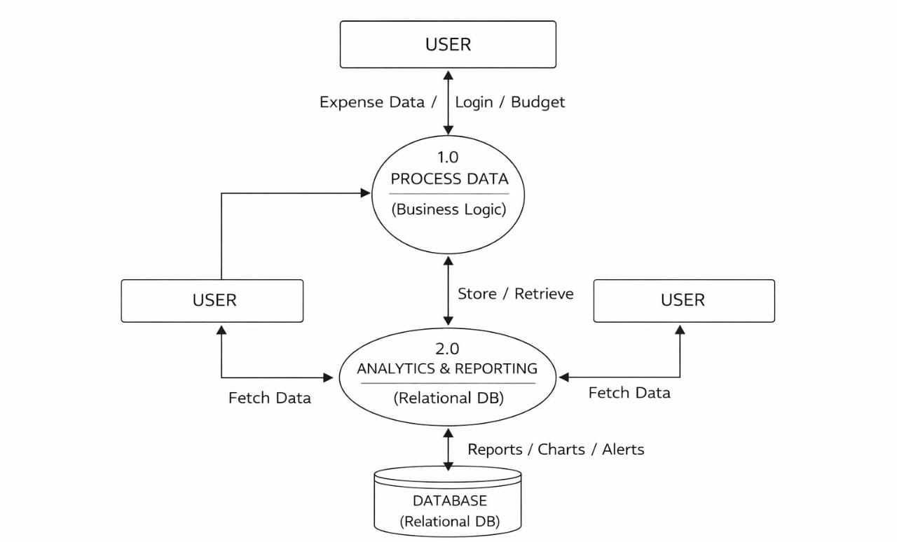
WORKFLOW
1
2
3
4
5
6
7
8
9

Slide 8
TECHNOLOGIES USED
Frontend:
HTML, CSS, and JavaScript for building web dashboards and interactive pages.
Forms for inputting transactions and visualizing analytics.
Backend:
Java programming language using Maven project structure.
Handles business logic, transaction processing, and analytics computations.
Database:
Relational database (MySQL) to store transactions, categories, users, and reports.
Supports querying, relational mapping, and report generation.
Tools:
Eclipse IDE for development and project management.
Maven for dependency management and build automation.
Browser for testing and running HTML pages.
Hardware/Software Requirements:
Software:
Java JDK 11 or above
Eclipse IDE with Maven support
Web browser (Chrome/Firefox)
H2 Database or MySQL (optional for persistent storage)
1
2
3
4
5
6
7
8
9

Slide 9
MODULE DESCRIPTION
Module 1: User Management Handles user login with secure authentication and role-based access.
Module 2: Expense Tracking & Core Processing Implements the main business logic for categorizing, processing, and storing user transactions efficiently.
Module 3: Database Management Manages relational storage of transactions, categories, and user data, ensuring integrity and fast retrieval.
Module 4: Analytics & Reporting Generates visual reports, charts, and insights to help users analyze spending patterns and make informed financial decisions.
1
2
3
4
5
6
7
8
9

Slide 10
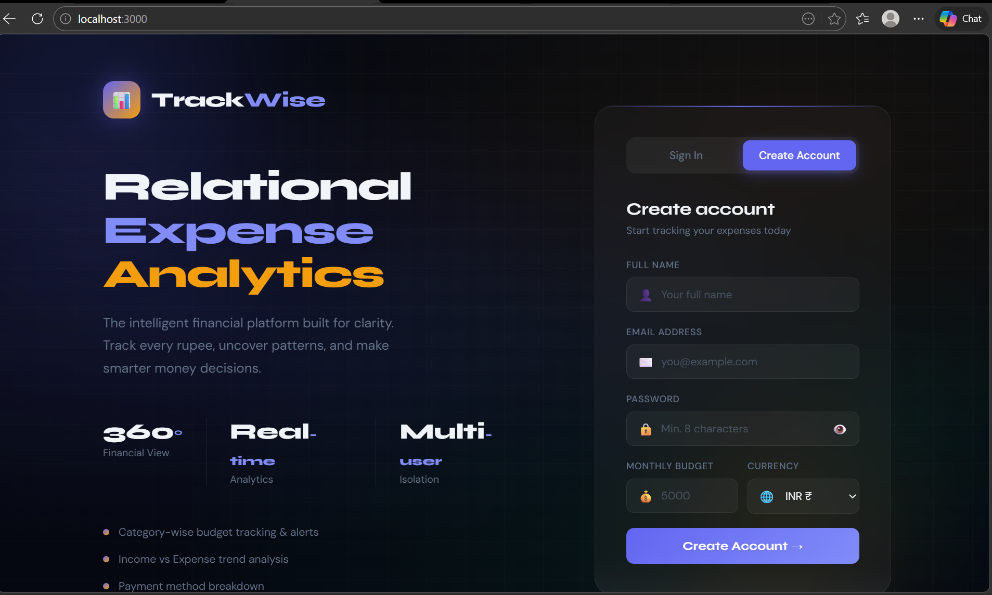
IMPLEMENTATION SCREENSHOTS
1
2
3
4
5
6
7
8
9

Slide 11
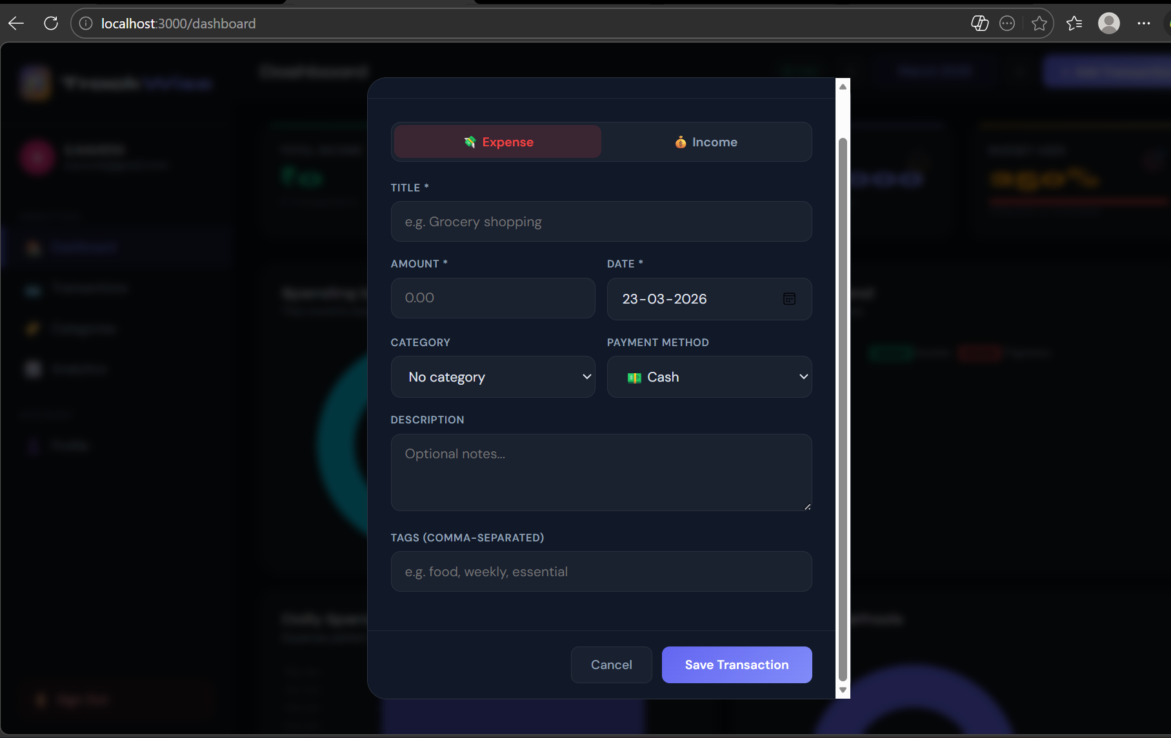
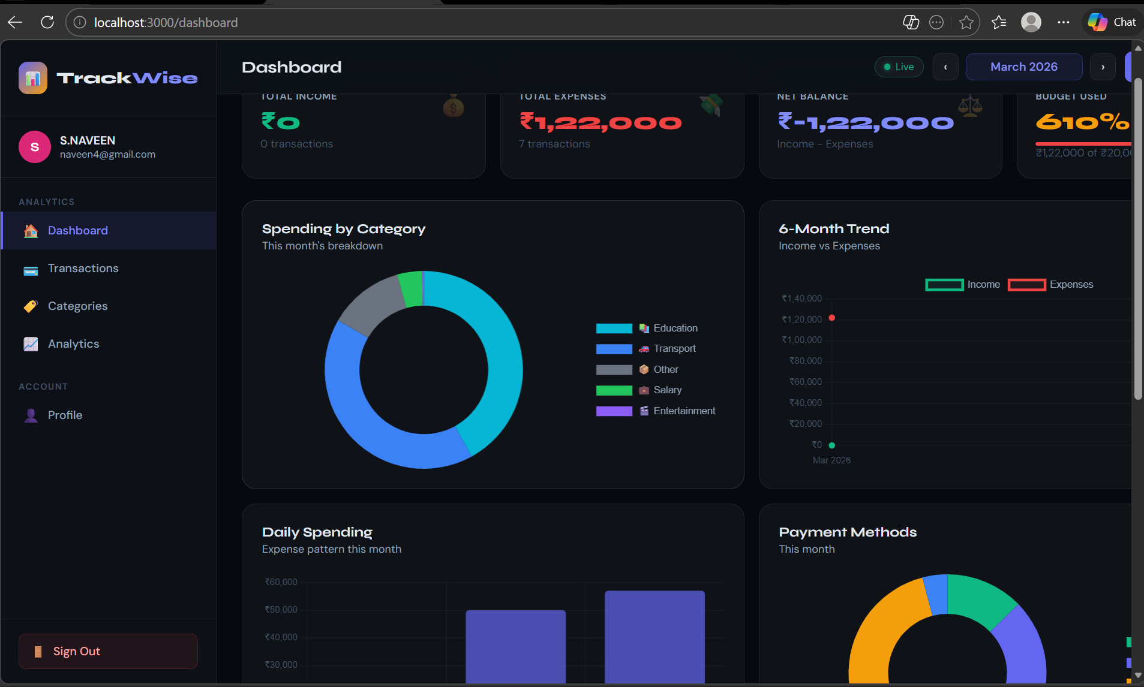
IMPLEMENTATION SCREENSHOTS
1
2
3
4
5
6
7
8(A)
9

Slide 12
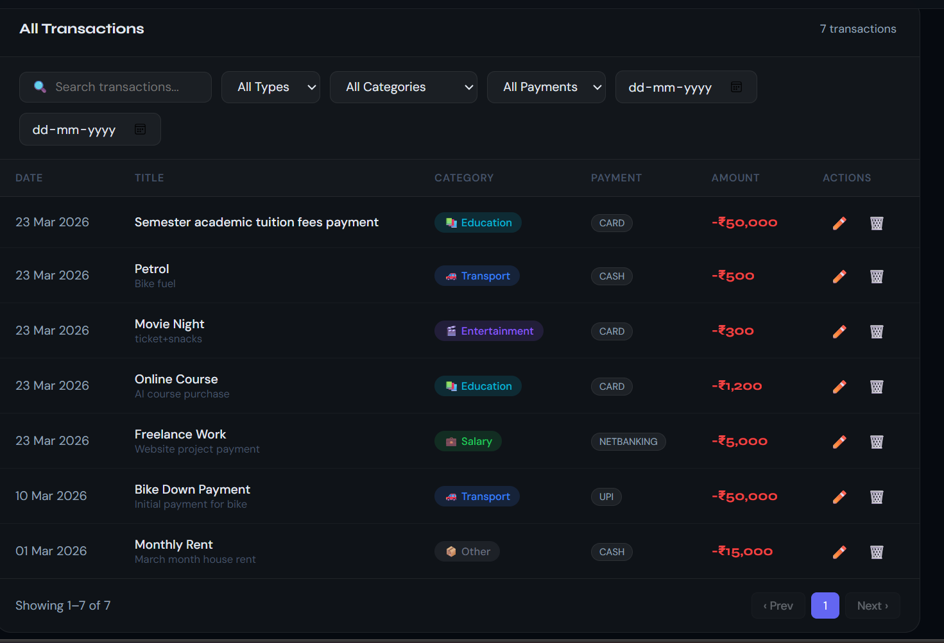
IMPLEMENTATION SCREENSHOTS
1
2
3
4
5
6
7
8(B)
9

Slide 13
IMPLEMENTATION SCREENSHOTS
1
2
3
4
5
6
7
8(C)
9

Slide 14
ADVANTAGES & LIMITATIONS
1
Advantages:
Efficient Expense Management: Automates tracking and categorization of transactions, reducing manual effort.
Data-Driven Insights: Provides visual dashboards and reports to help users make informed financial decisions.
Budget Optimization: Alerts and recommendations help minimize unnecessary expenses and improve budgeting.
Improved Accuracy: Reduces errors compared to traditional spreadsheet-based tracking.
Limitations:
Dependent on Accurate Input: Analytics are only as good as the data entered by users.
Limited Scalability: Designed mainly for personal or small business use; may require upgrades for large enterprises.
Requires Setup: Web dashboards need proper environment and browser access to function.
Basic Predictive Features: Advanced forecasting or AI recommendations are not included by default.
2
3
4
5
6
7
8
9

Slide 15
Thank you

